Slide 1

Advanced Legal Research & Writing Requirement
Susan Schneider
LL.M. Program in Agricultural and Food Law
University of Arkansas School of Law
August 28, 2026

Slide 2
LL.M. Degree Requirement
All LL.M. candidates are required to satisfy the Program's research & writing requirement by preparing "a written product for graded credit" that "demonstrates rigorous legal analysis, significant academic content, and quality legal writing skills."

Slide 3
Type of Writing
Law Review style article
Practice-oriented article or handbook
Other legal publication (e.g., amicus brief, federal register comment)
“rigorous legal analysis, significant academic content, and quality legal writing skills”

Slide 4
Basic Requirements
Length: at least 6000 words in length. At an average of 250 words per page, this translates to a usual minimum of 24 pages of double-spaced text. Most are longer.
The article must be concise and well-written.
The article must be your own words (no joint authorship; no generative AI)
All plagiarism rules must be adhered to
The article must be appropriately cited to relevant sources, typically Bluebook citation in footnote form

Slide 5
Suggested Process
General research
Topic selection
In-depth research
Develop an abstract to refine your topic
Develop an outline that tells the story
Begin work on one section at a time
Rough draft by October 16 (for Dec. graduation)
Final article by November 30 (for Dec. graduation)

Slide 6
Tips
Keep citation notes for all your resources
Set aside specific times for this project
It will take significantly more time than you anticipate, so be prepared to budget your time and prioritize completion
Allow yourself the freedom to change your analysis and shift your topic based on your research

Slide 7
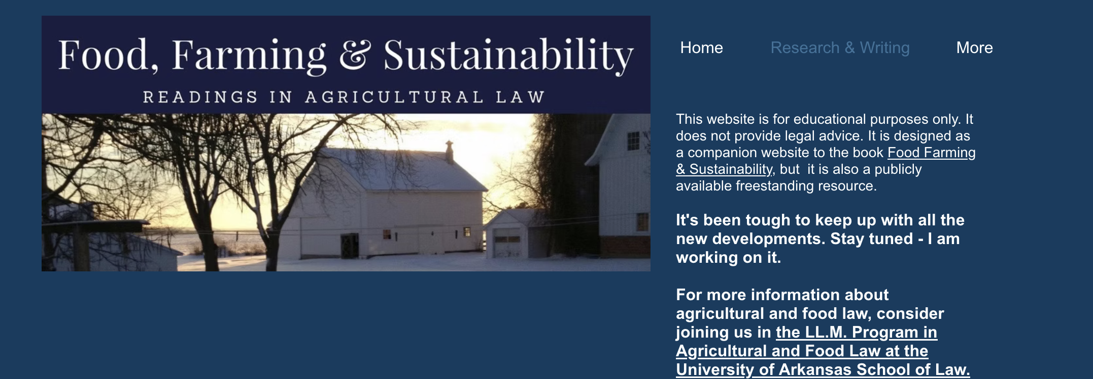
Introduction to FoodFarmingSustainability.com
General resource site
Research & Writing Resources

Slide 8

Plan for the Semester
Week 2 - Aug. 28, 2026
Topic Selection
Week 3 - Sept. 4, 2026
Online research tools available through the Young Law Library
Week 6 - Sept. 25, 2026
Strategy and Problem Solving
Week 7 - Oct. 2, 2026
Citation Basics: Using Primary Authority
Citation Basics: Bluebook Citation
Week 8 – Oct. 9, 2026
Week 9 - Oct. 16, 2026
Student Rough Draft Deadline
Student presentations
Week 5 - Sept. 18, 2026
AI Technology and Legal Scholarship
Tentative: Additional tips from Professor Kelly Nuckolls
Developing a timeline for completion
Week 4 – Sept. 11, 2026
Plagiarism and the copy-paste trap

