Slide 1
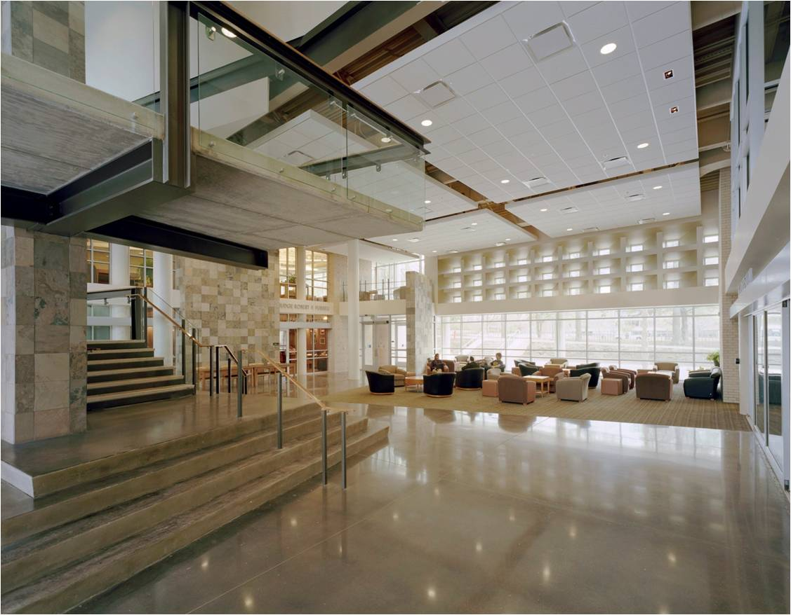
LL.M. Program in Agricultural and Food Law
University of Arkansas School of Law
Fayetteville, Arkansas

Slide 2

Fully integrated program combining students on-campus and students learning by distance

Slide 3
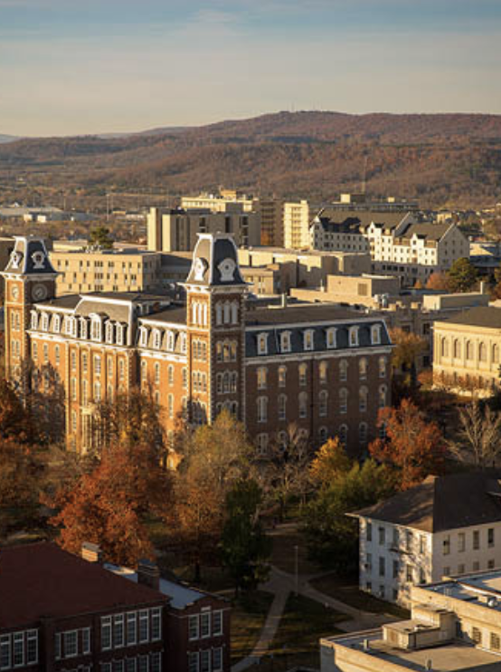
On-campus students enjoy living in Fayetteville
Consistently rated as among the best cities to live in America
Foothills of the Ozark Mountains
The Razorback Greenway with 40 miles of walking and biking trails
Legendary live music scene
Ozark Natural Foods
A vibrant Farmers Market and many local food restaurants
Walton Arts Center

Slide 4
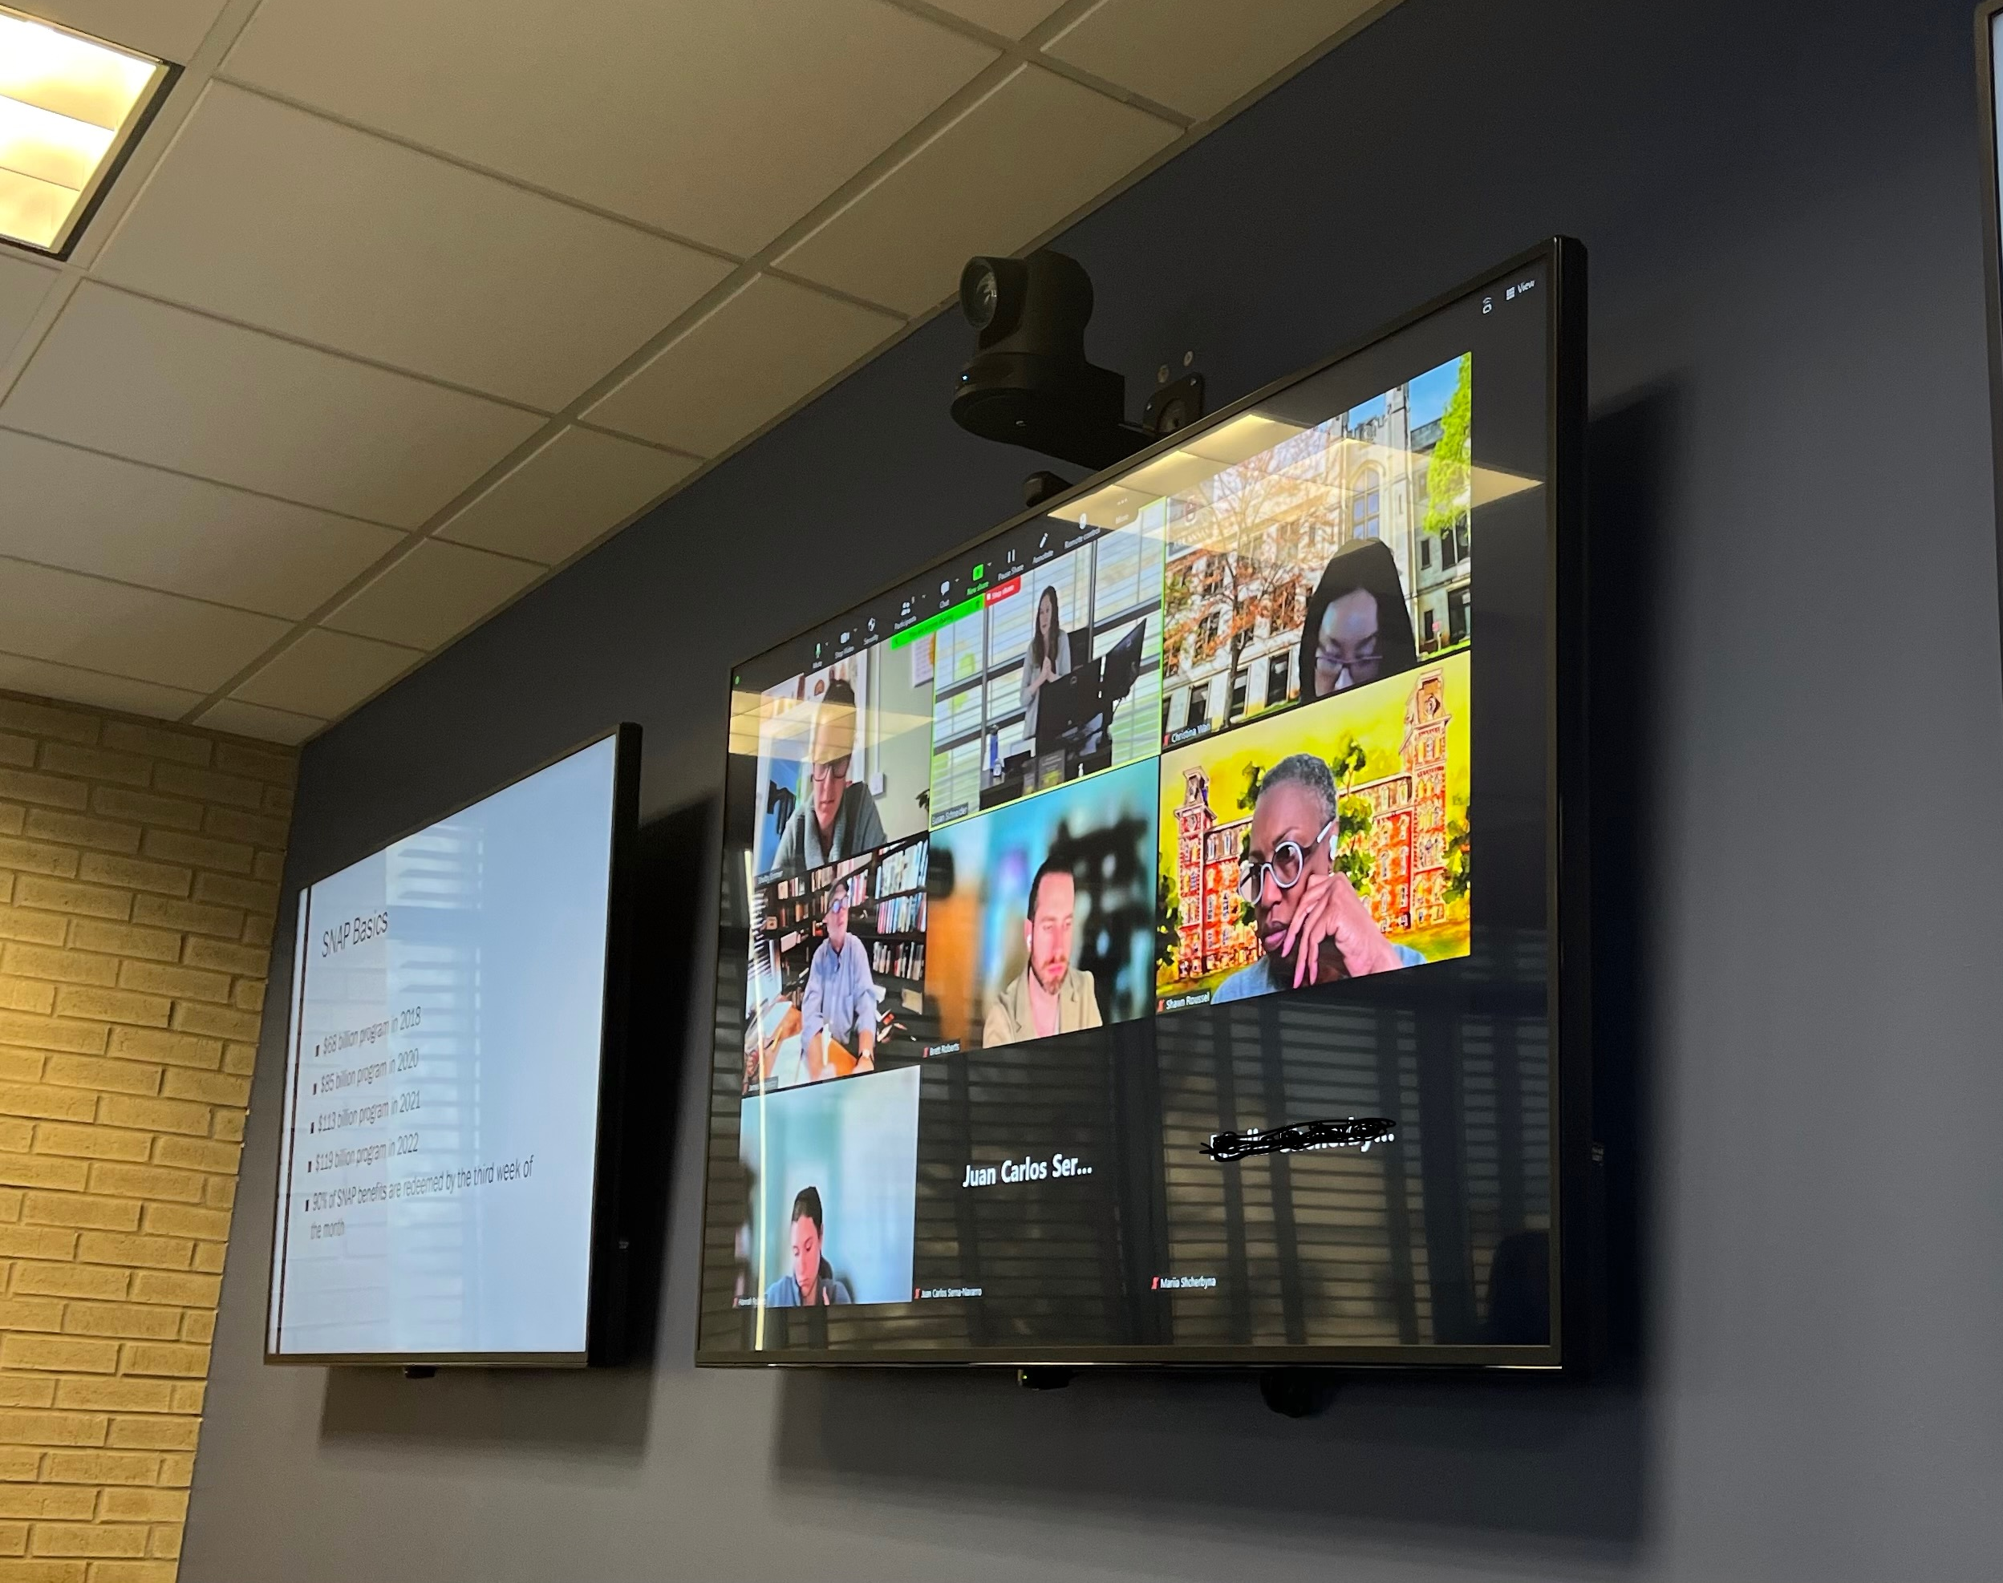
Our distance students connect with us through video-conferencing from their home or office

Slide 5

Most of our classes are synchronous
Direct contact with your professor and with other students in the class
Advanced technology and support to bring our distance students into the classroom
Classroom capture to provide flexibility if students need to miss class for other obligations

Slide 6

We also offer asynchronous classes
Allowing students to learn on their own, online
Classes developed with the distance education professionals at the University of Arkansas Global Campus
Opportunities provided for discussion and Q&A with the professor

Slide 7
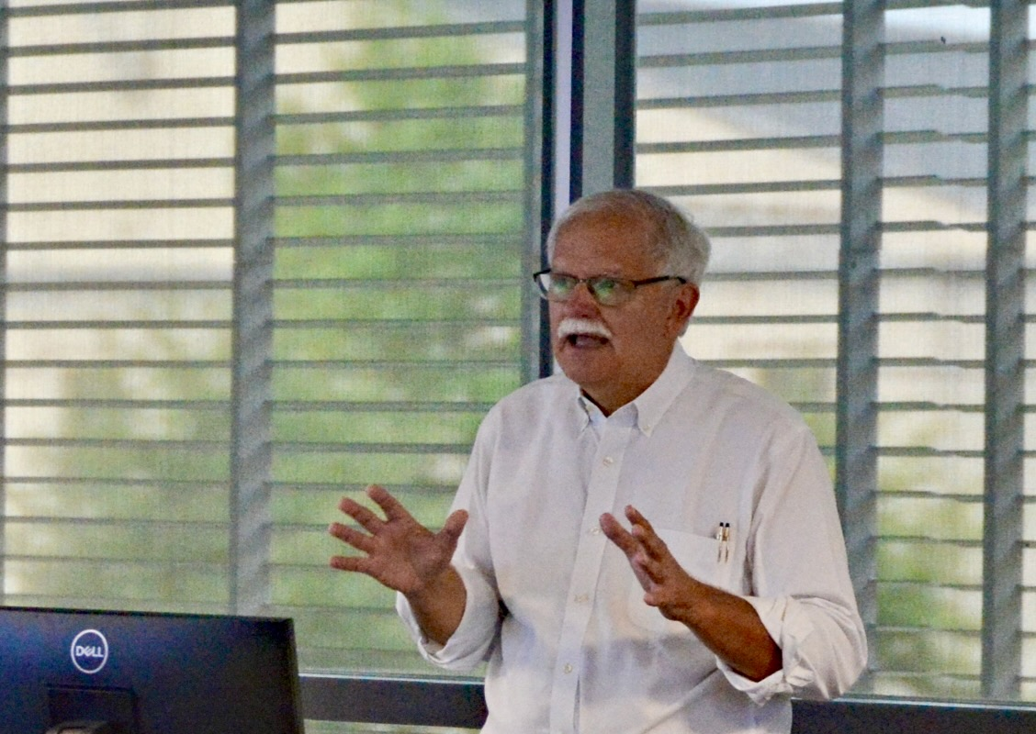
Special condensed courses
Allowing students to immerse themselves in a course over several days
Taught by nationally recognized food and agricultural law leaders

Slide 8
What are the requirements for the degree?
Only 24 credits;
5 required courses
Agriculture & the Environment
Food Law & Policy
Food, Farming & Sustainability
Agricultural Perspectives
Advanced Writing in Agricultural & Food Law

Slide 9

Additional Electives Designed Specifically for the LL.M. Program
Federal Regulation of Food
Agricultural Administrative Law
Legal Issues in Indigenous Food & Agriculture
Competition and Antitrust in Ag & Food
Nutrition Law & Policy
Intellectual Property in Food & Agriculture
Food Safety Litigation
Legal Issues in Land Tenure
Agricultural Cooperatives
Agricultural Water Law
Intro to Ag Taxation
Farm Succession Planning
Effective Legal Writing
Right to Food
Business Human Rights and Corporate Social Responsibility in the Food and Ag Sector
Practicum in Agricultural & Food Law
Selected Issues in Food & Agricultural Law
Guided Independent Study Opportunities

Slide 10
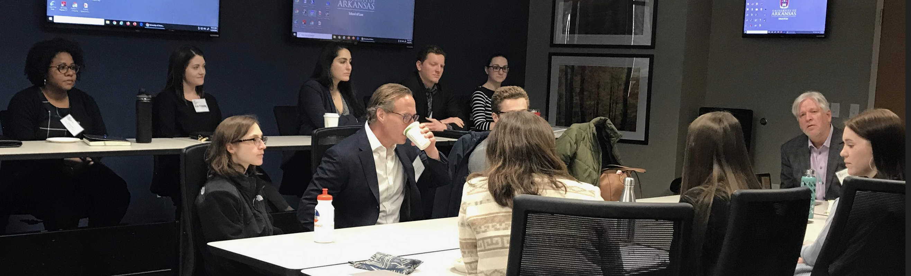
Who are our students?
Many are experienced professionals
Some are recent law graduates
A wide variety of backgrounds and locations
All are enthusiastic to learn about agricultural and food law issues

Slide 11
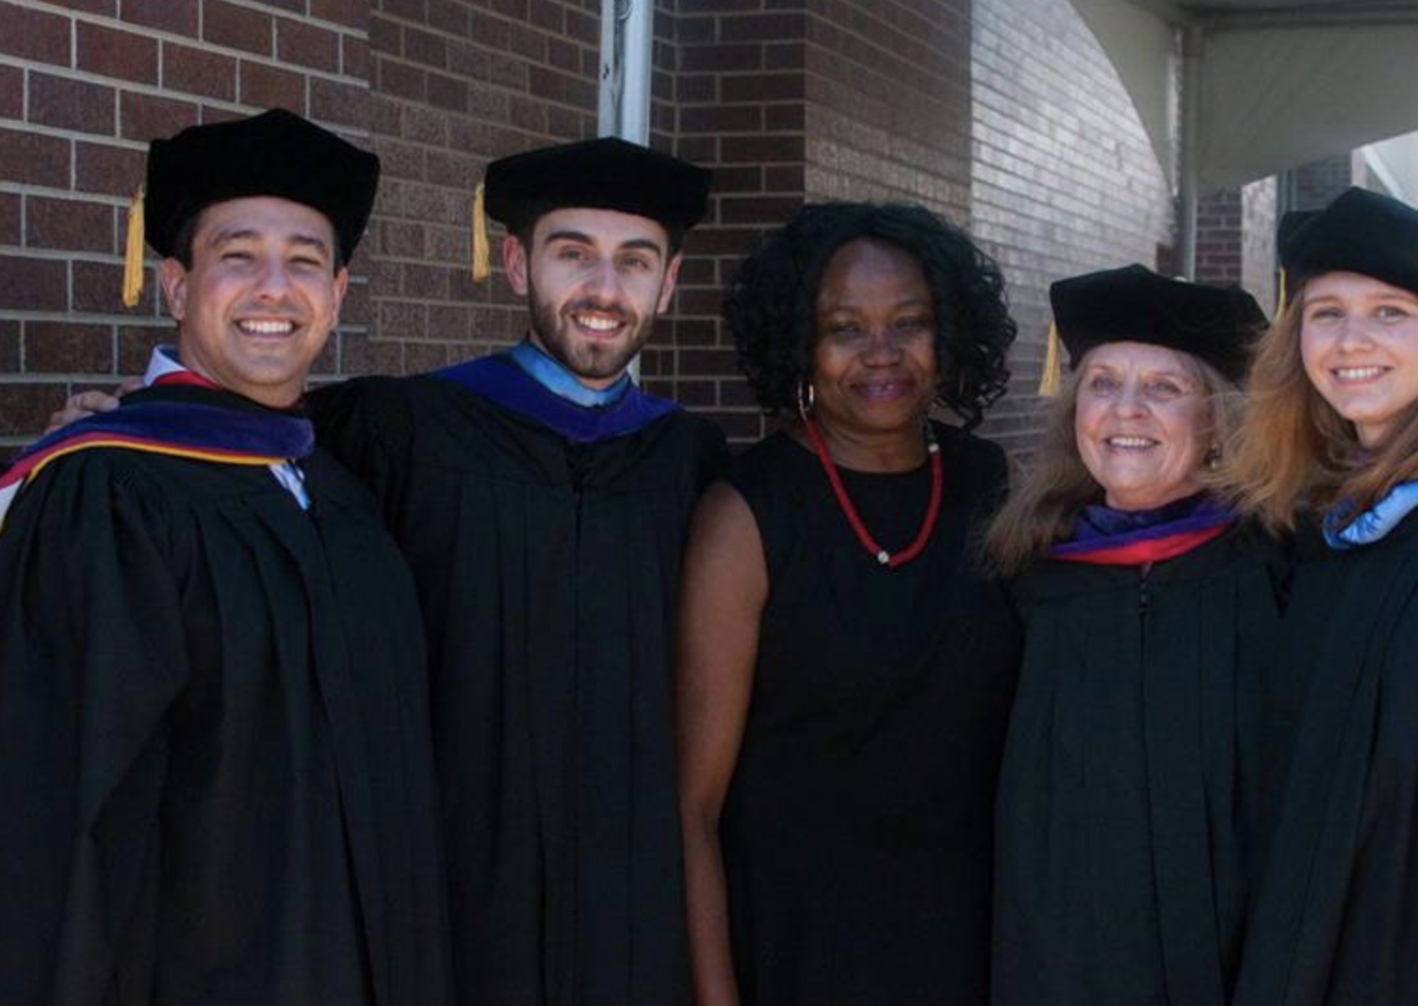
How long does it take to earn the degree?
Full time students can earn their degree in two semesters
Part-time students can take up to four years

Slide 12
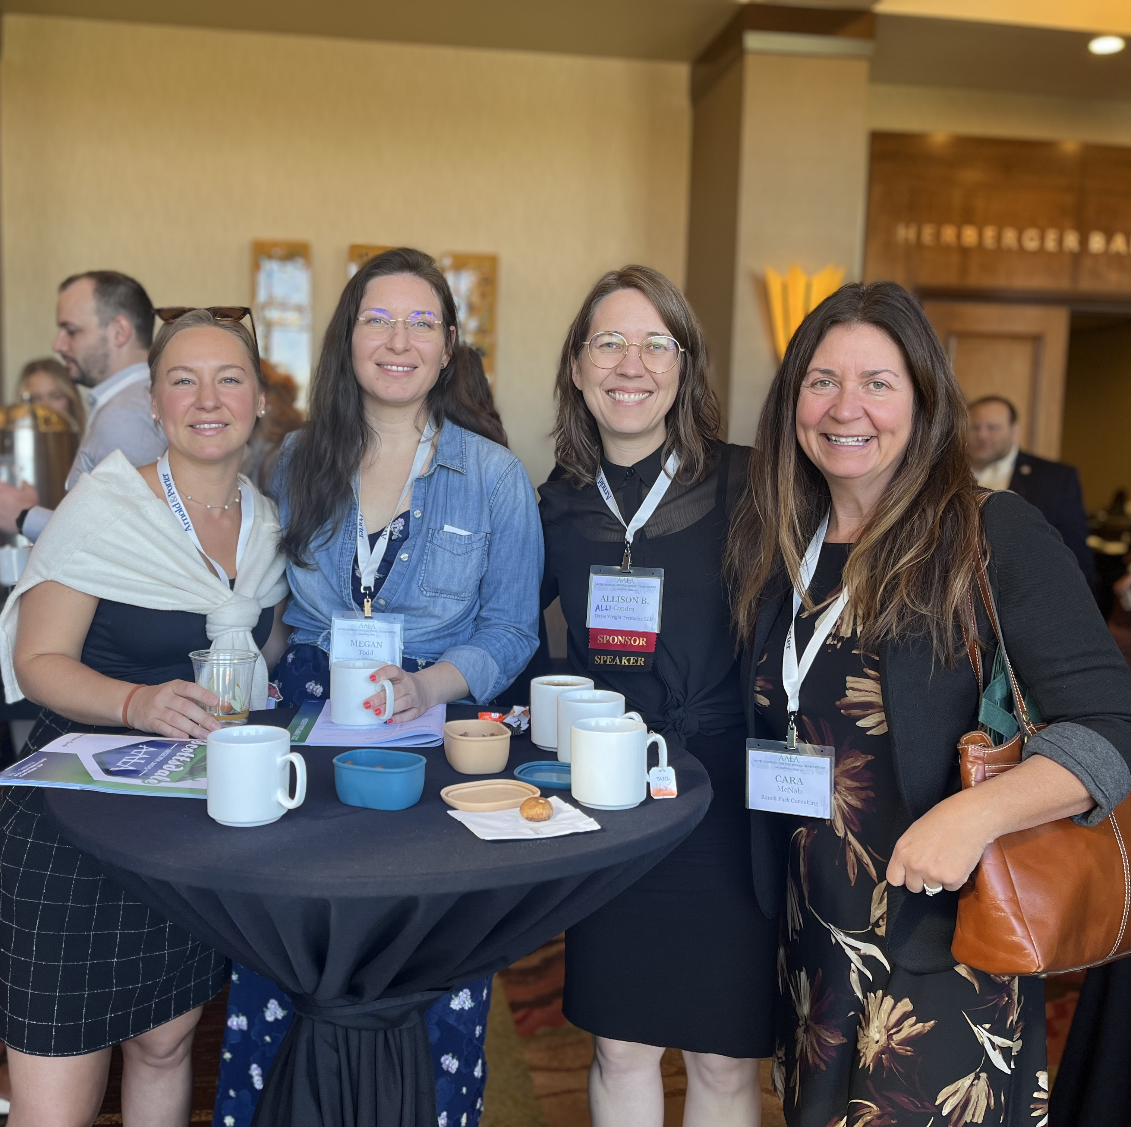
How does our LL.M. Program Differ from Law School?
Professional learning environment
Collaborative and not competitive
Exams designed to further the learning experience
Students treated as professionals

Slide 13
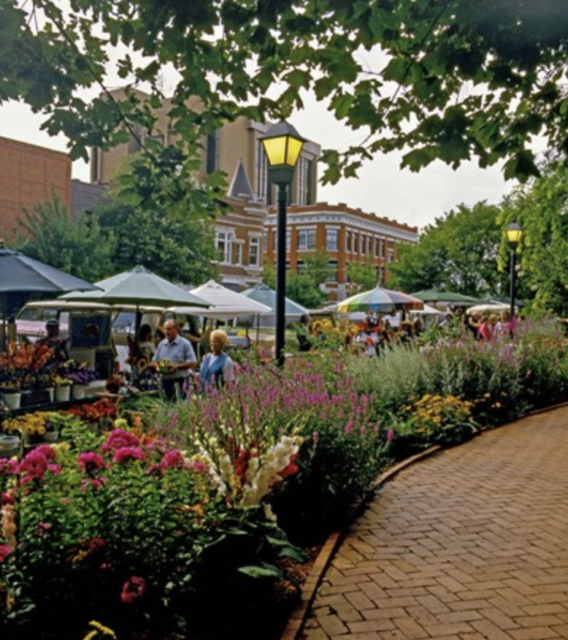
How much does it cost?
Our LL.M. tuition is lower than any of our competitors
Pay only for the courses you take, when you take them
Full-time on campus students may apply for a Graduate Assistantship (tuition waiver plus a stipend)
Distance students pay in-state tuition of only about $600 per credit
Scholarships may be available

Slide 14
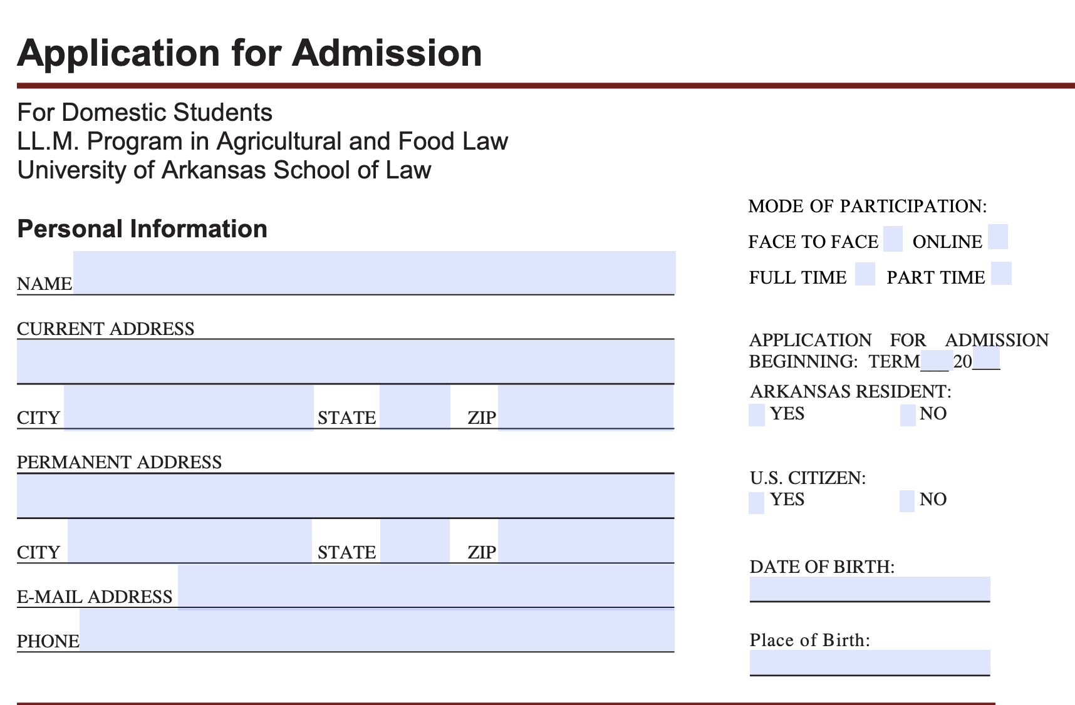
How do I apply?
Go to our website at law.uark.edu/llm
Go to “How to Apply”
Application
Resume
Letter of recommendation
Transcripts
No fee

Slide 15
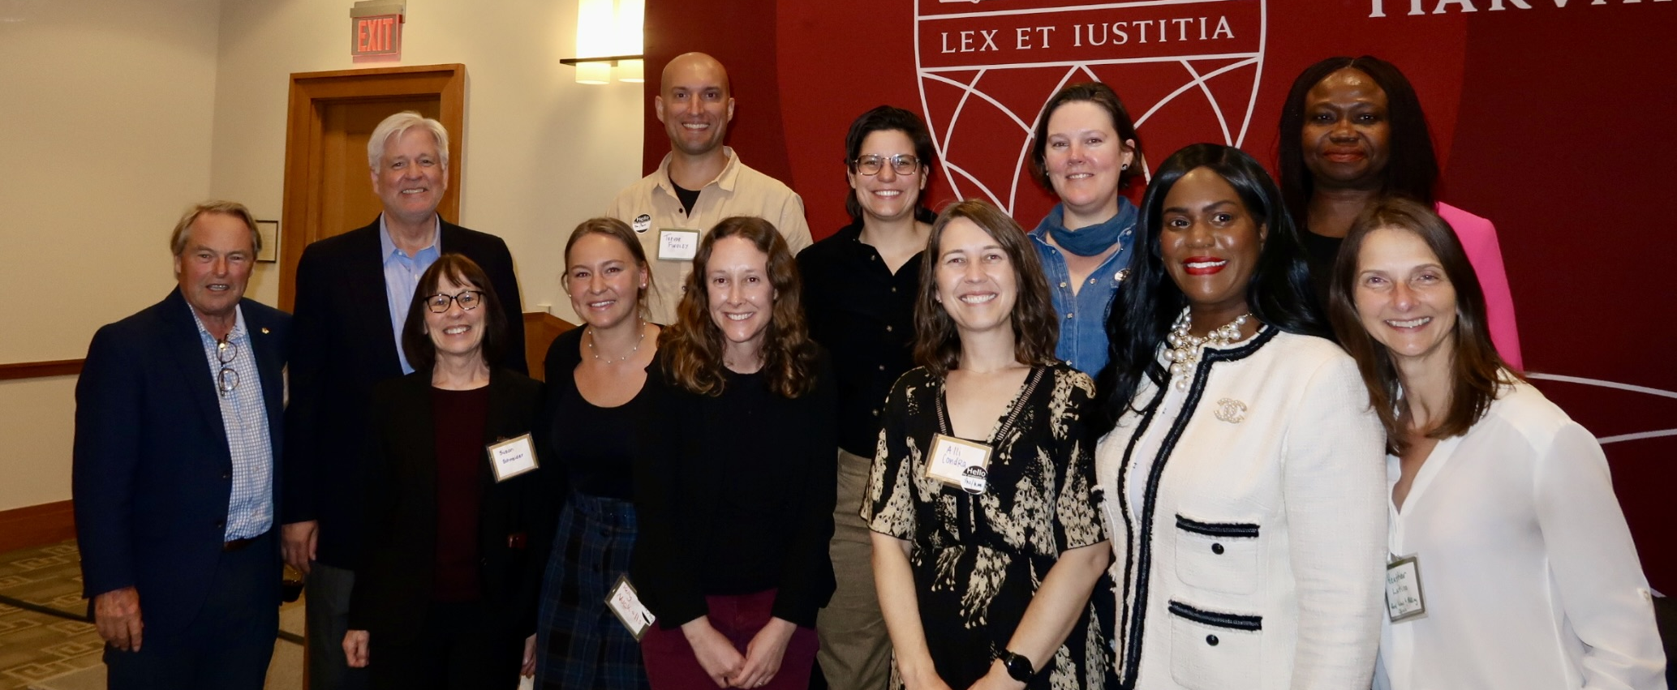
Join our Network of Ag & Food Law Professionals

Slide 16
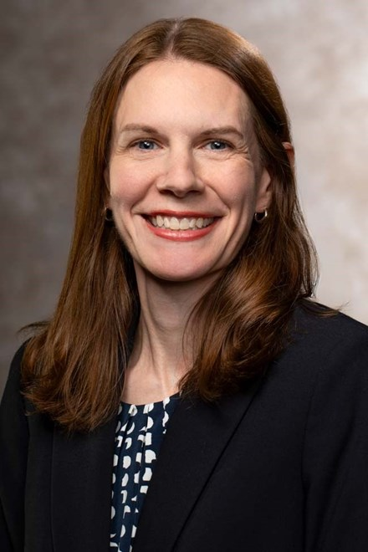
Contact us for more information
LLM@uark.edu
(479) 575-3706
Visit our blog – agfoodllm.com
Visit our website to learn more or to apply: law.uark.edu/llm
Pictured here is our Program Manager, Emily Bridges who handles all our admissions questions and can connect you to Program Director Susan Schneider, Assistant Director Kelly Nuckolls, or any of our professors.

