Slide 1
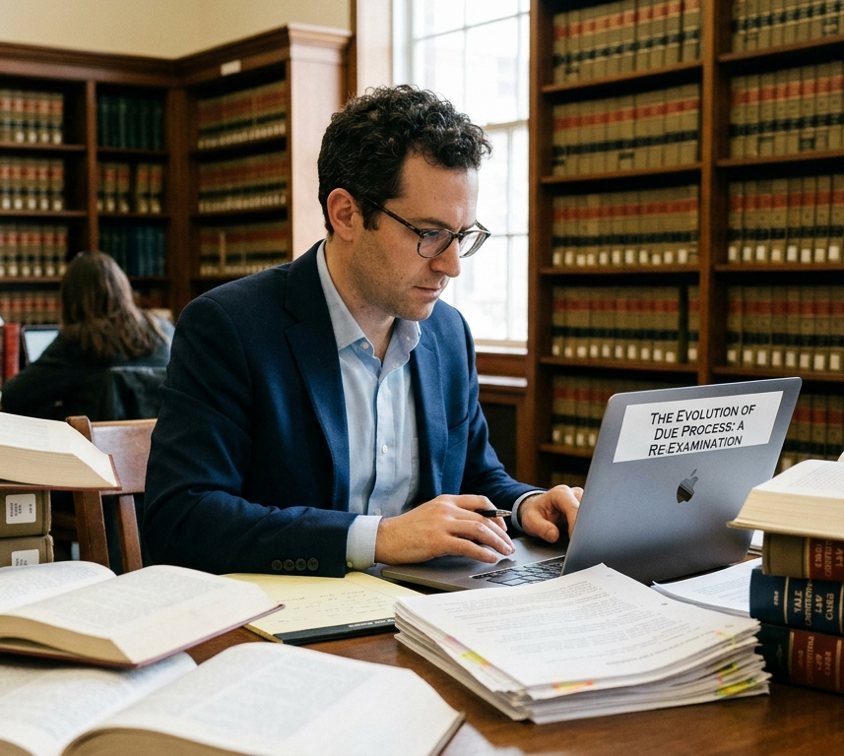

Citation of Sources
Advanced Legal Research & Writing
October 2, 2026

Slide 2
What has to be cited
The research that you relied for any statement of fact
Source of any data or statistics
The ideas or arguments from anyone else
Graphics, photos, media produced by others.
The source for any quotation (plus quotes if word-for-word)
Distinctive phrases or terms coined by others
Data, statistics, or facts produced or documented by others.

Slide 3

Citations Establish Credibility
Provide proof of your research
Bolster your argument
Evidence good quality research and writing
Enhance your chances for publication

Slide 4
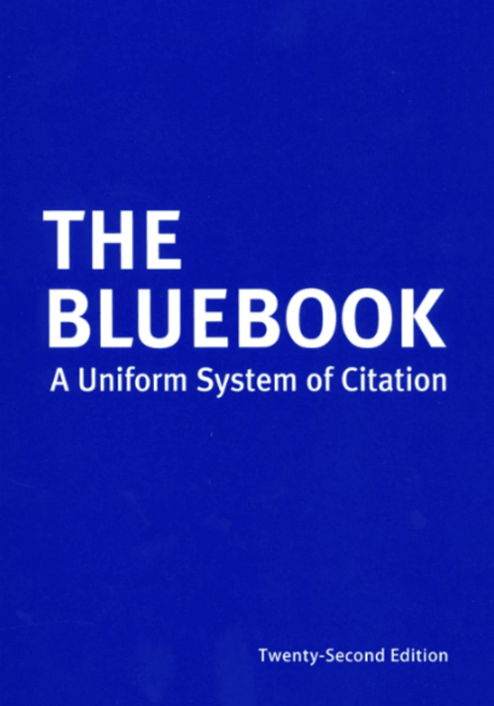
Bluebook
The standard form for legal citations
Some differences between law review and court documents
Basic rules for different categories of citation

Slide 5
Get all the information you need for a proper citation when you first rely on a source

Slide 6

What to cite? Primary Authority
Example to discuss:
Suppose you want to write about the new law in California that establishes a label for foods that are not ultra-processed. You read about it in a news article: Mary Kekatos, What to Know About California Ultra-processed Foods Label Law, ABC News (Sept. 29, 2026) available at https://abcnews.com/Health/californias-new-ultra-processed-foods-label-law/story?id=136848155.

Slide 7
What if you want to publish your article online instead of a law review article?
Talk to us to explain
Hyperlinks can be embedded in the article instead of using footnotes, but the same rules on what to cite apply
Double check the accuracy and currency of your sources
The importance of primary citation is also the same
Talk to librarians about obtaining permanent cites for webpages

